Slide 1

«Գիտական ստորաբաժանումների ամրապնդման ծրագիր - 2024» մրցույթ
[68Ga]GaCl3-ի վերջնական արտադրական տեխնոլոգիայի մշակում
ԱԱԳԼ, Իզոտոպների հետազոտման և արտադրության բաժին
Ճարտարագիտություն և տեխնոլոգիա 2.7 Բժշկական սարքաշինություն
24LCG-2G028
Ղեկավար՝ Ռ. Դալլաքյան
Կատարողներ՝ Ա. Մանուկյան, Ն. Դոբրովոսկի, Ա. Գրիգորյան, Դ. Արշակյան, Կ. Հովհաննիսյան, Վ. Էլբակյան
Արտասահմանյան գործընկեր՝ prof. Francisco Alves
ICNAS – Institute for Nuclear Sciences Applied to Health, University of Coimbra, Portugal
ԱԱԳ2026 Դիլիջան, մայիսի 16, 2026 թ․

Slide 2
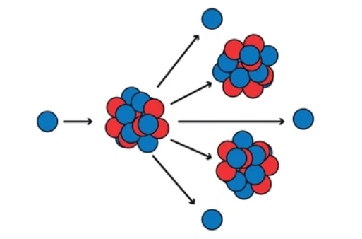
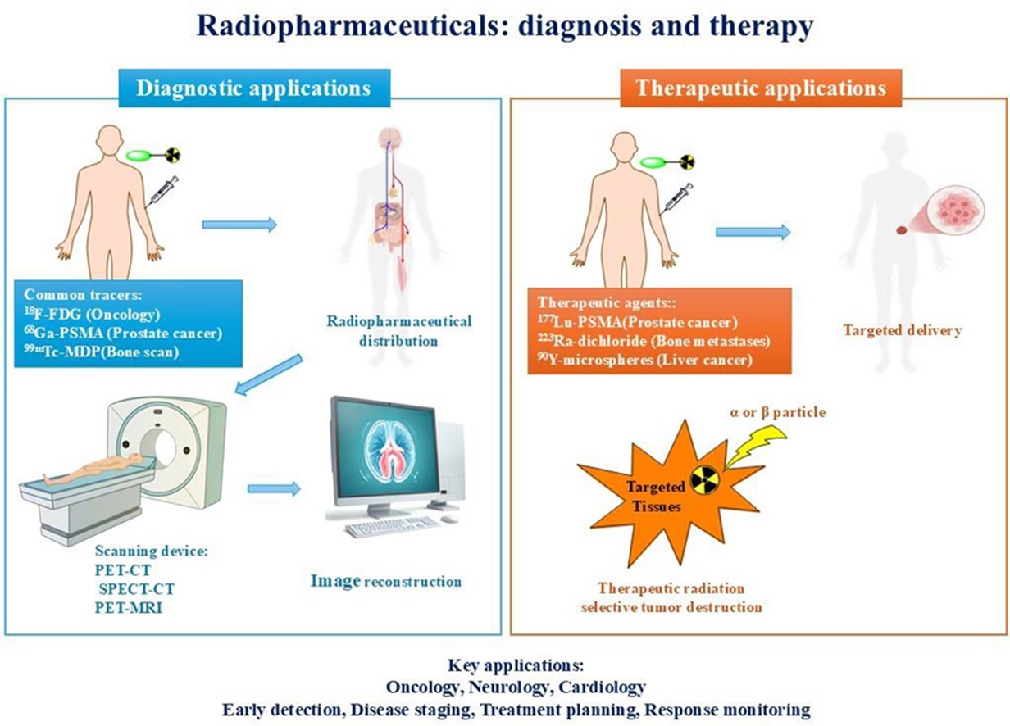
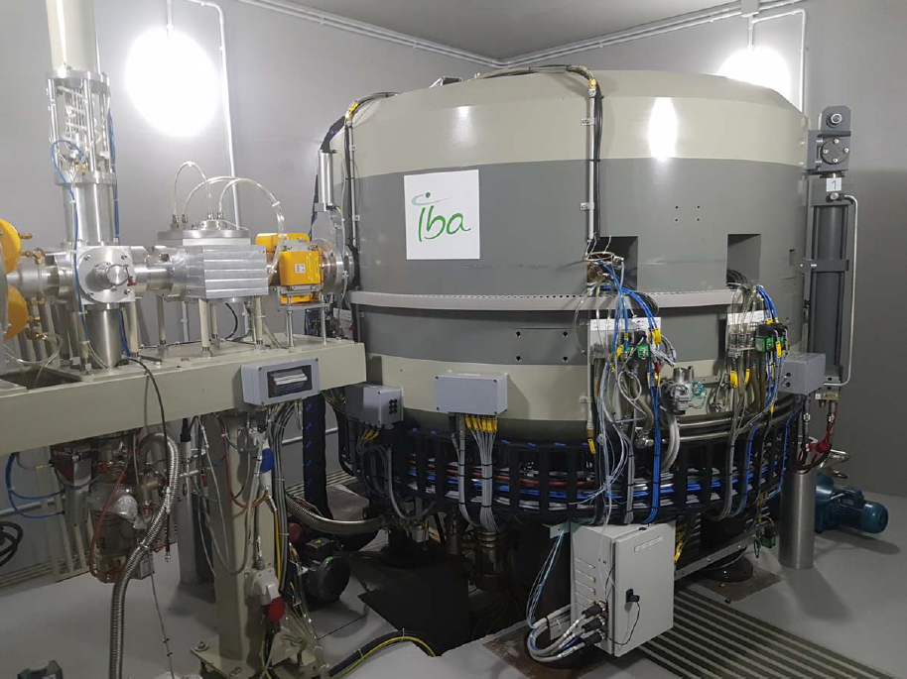
Medical radioisotopes and radiopharmaceuticals

Slide 3
IMPORTANCE OF Ga-68
Gallium-68 (68Ga, t1/2 = 67.71 min, ) decays 87.94% through positron emission with a maximum energy of 1.9 MeV, mean 0.89 MeV.
68Ga3+ cation can form stable complexes with many ligands containing oxygen and nitrogen as donor atoms. This makes 68Ga suitable for complexation with chelators and various macromolecules, allowing for kit development.
Ga-68 is widely used with Lu-177, and Y-90 due to its relevant chemical properties
Compared with Ge/Ga generators, the direct production methods are cheaper and provide just the required production activity per irradiation, significantly decreasing the final cost of the product.

Slide 4
Ga-68 importance as a theranostic pair
Development of theranostic agents for the PET imaging (68Ga) and either
alpha (213Bi, 225Ac)
or beta (90Y, 177Lu) therapy of neuroendocrine tumors (NETs) and Prostate cancer (PCa) further increase the demand for 68Ga-based radiopharmaceuticals.

Slide 5
[68Ga]GaCl3 production chain
Nuclear reaction - 68Zn(p,n)68Ga
Solid target preparation from enriched Zn-68
Target irradiation under proton beam
Solid target dissolution
Ga-68 purification, [68Ga]GaCl3 production
Quality Control
Radiopharmaceutical labeling

Slide 6
Targets for Ga-68 production:
Liquid or Solid?
It is easy to work with Liquid targets: target filling and transportation after the irradiation
low activities
Solid targets allow higher activities
need for additional equipment development for transportation and dissolution
less usage of the enriched target material

Slide 7
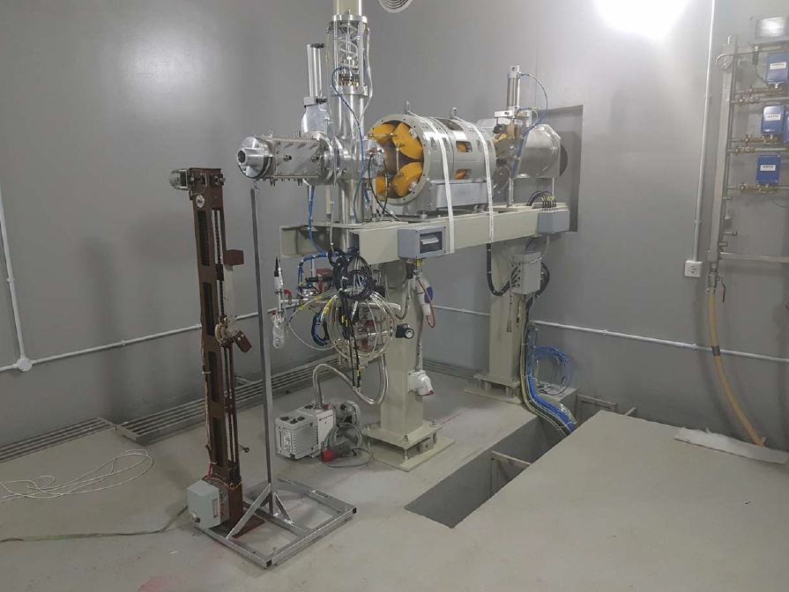
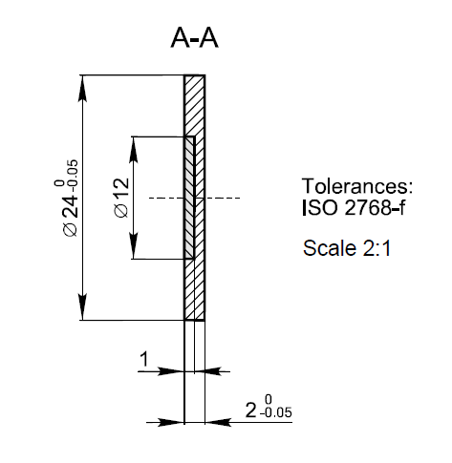
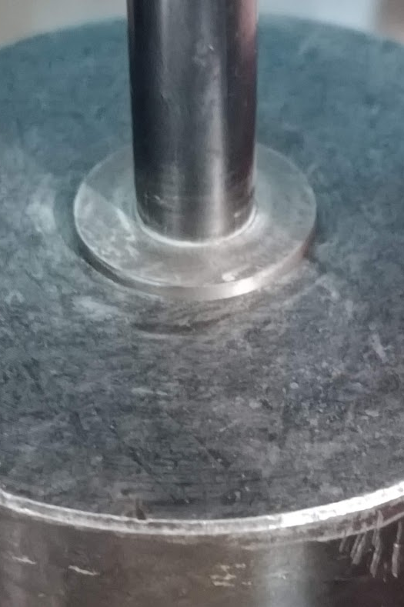
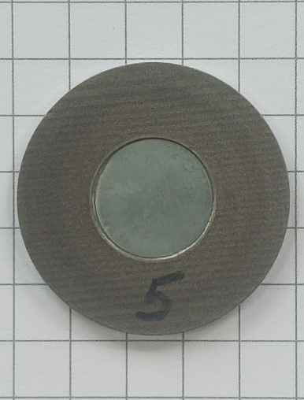
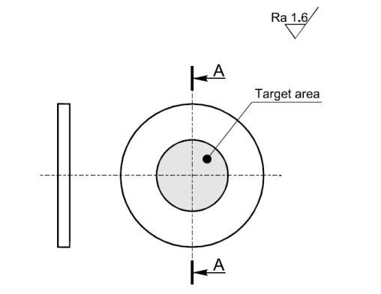
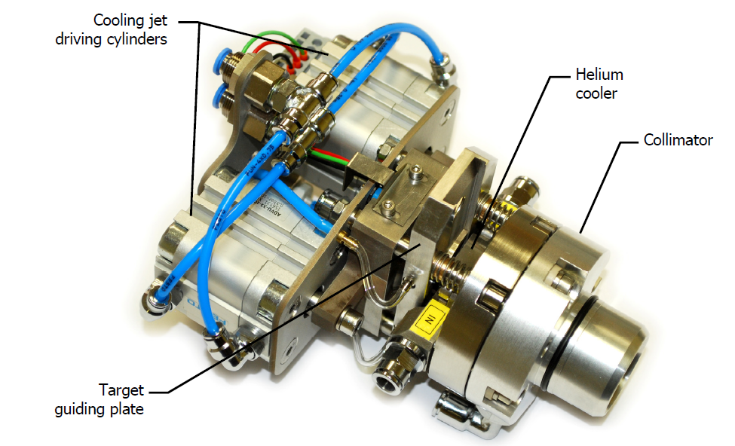
Solid target preparation
100 mg metallic Zn powder is pressed with 30 kN force of a hydraulic press on a Niobium target holder: successfully tested under 20 mkA proton beam intensity

Slide 8
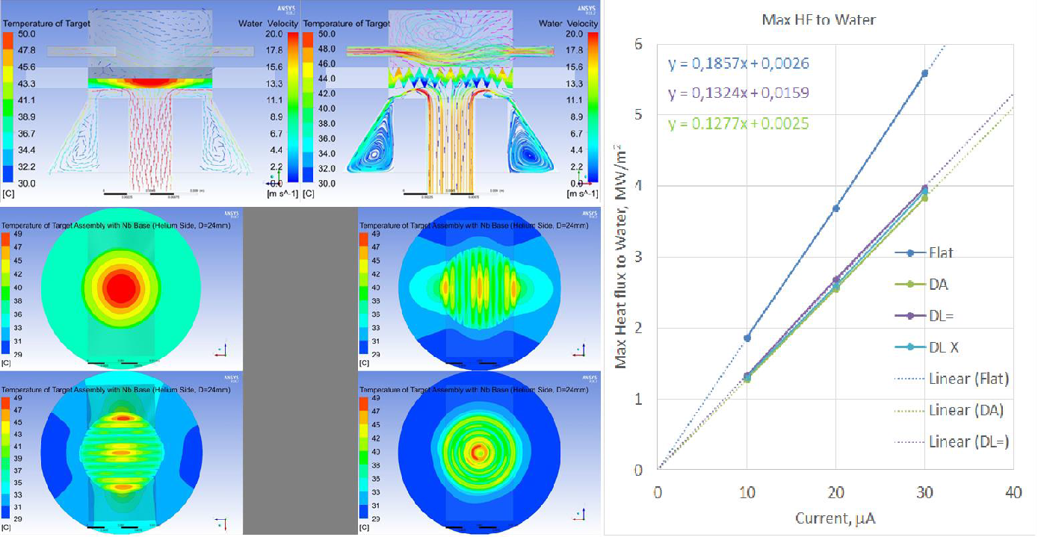
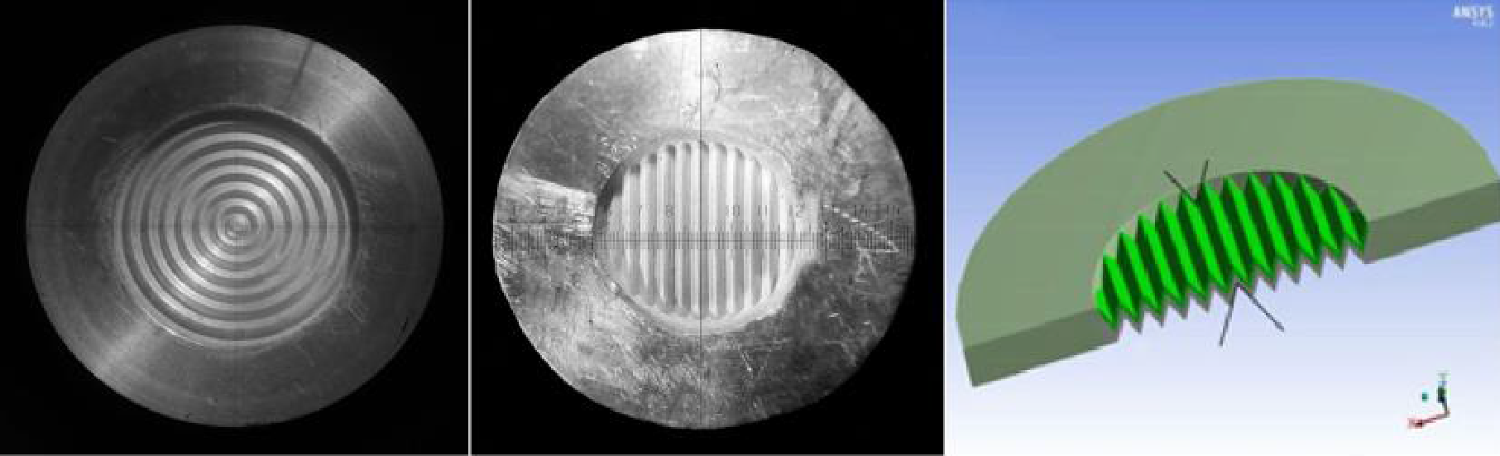
LIT target technology

Slide 9
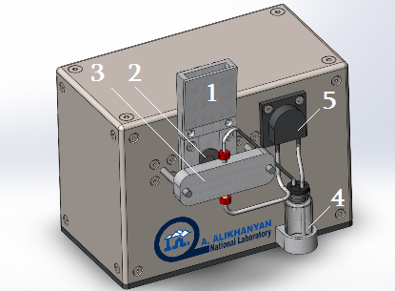
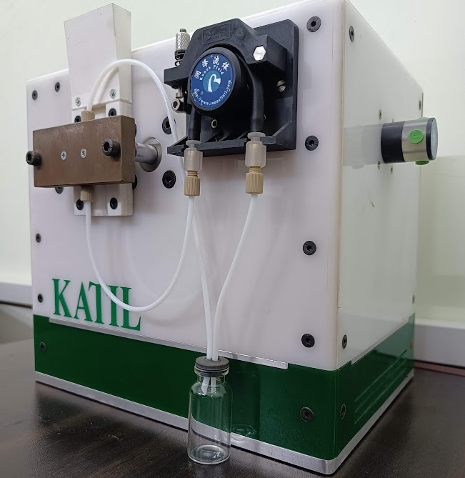
Solid target dissolution Station “KATIL” developed at AANL
Katil (կաթիլ) - means drop in Armenian.
KATIL dissolution system:
receiver,
target holder's final position,
dissolution vial,
dissolution solution vial (HCl), meanwhile dissolved target vial,
peristaltic pump.

Slide 10
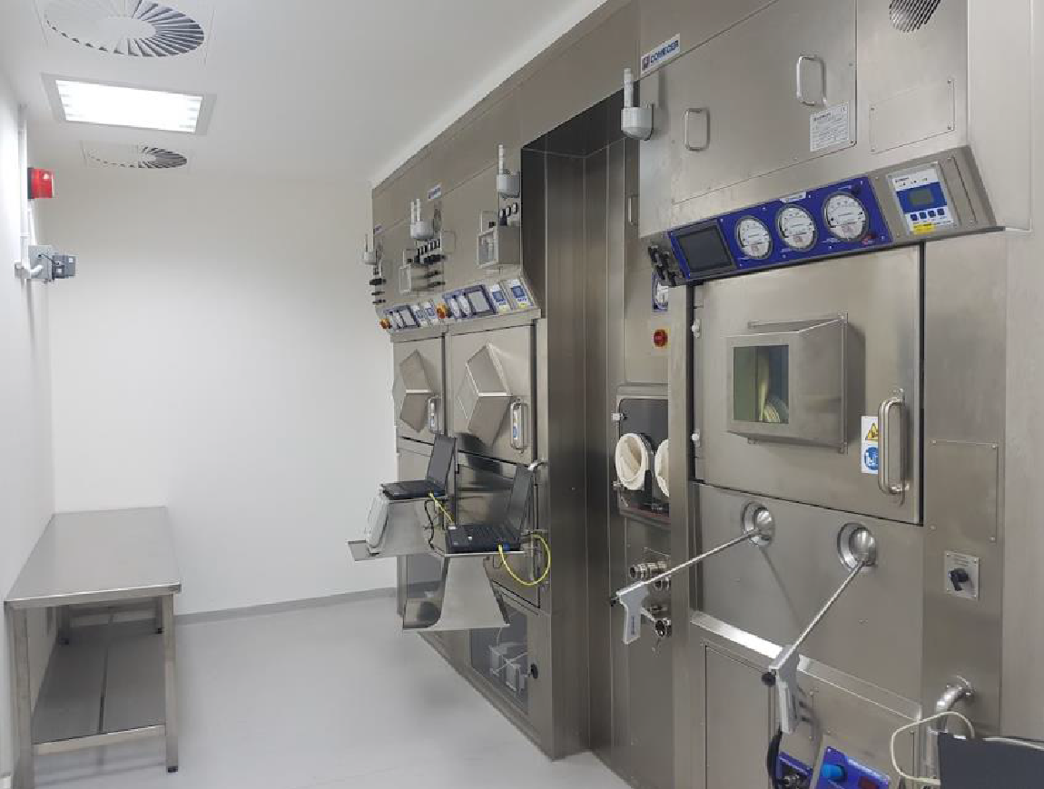
Hot Cells in the Hot Lab at RPC center

Slide 11
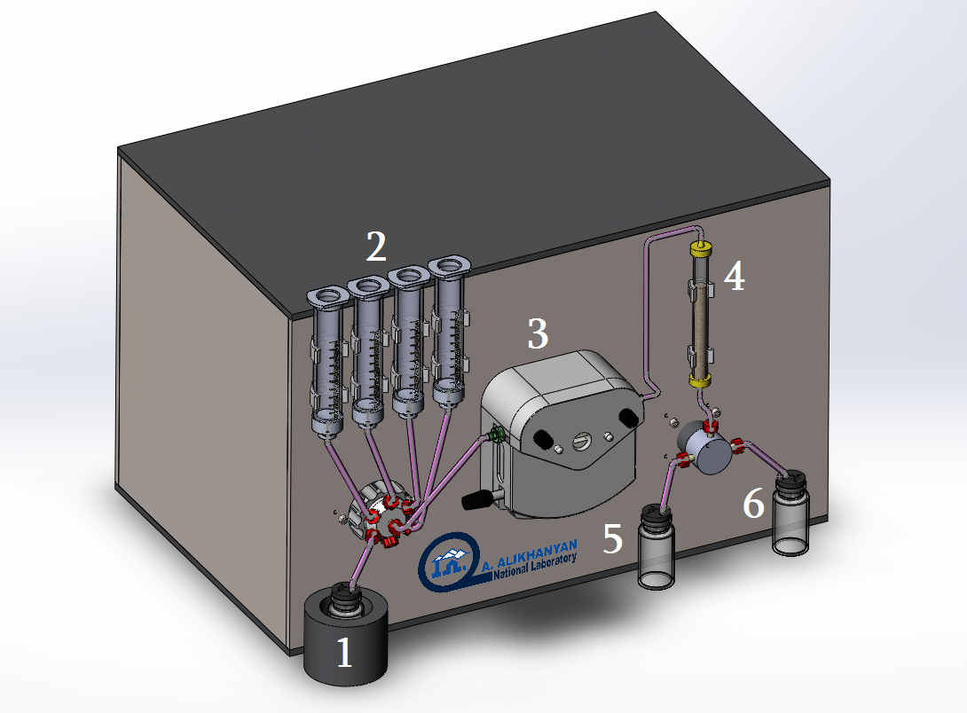
Purification station “JINJ” developed in AANL
Jinj (ջինջ) - means pure in Armenian
The purification station: (1) vial with the dissolved target,
(2) vials for the solutions for the resin activation and other processing steps,
(3) peristaltic pump,
(4) column with a resin,
waste vial,
product vial.

Slide 12
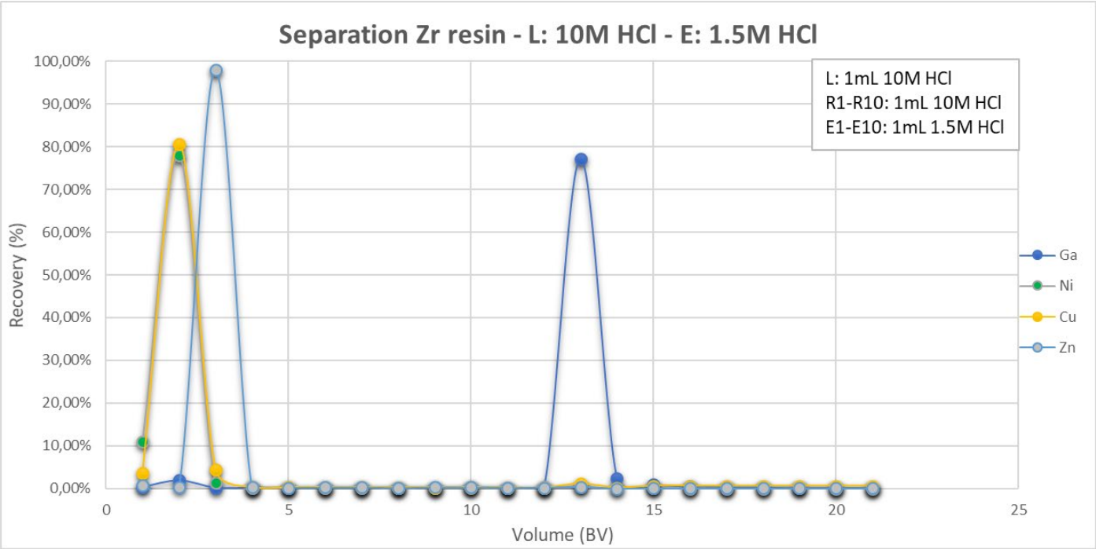
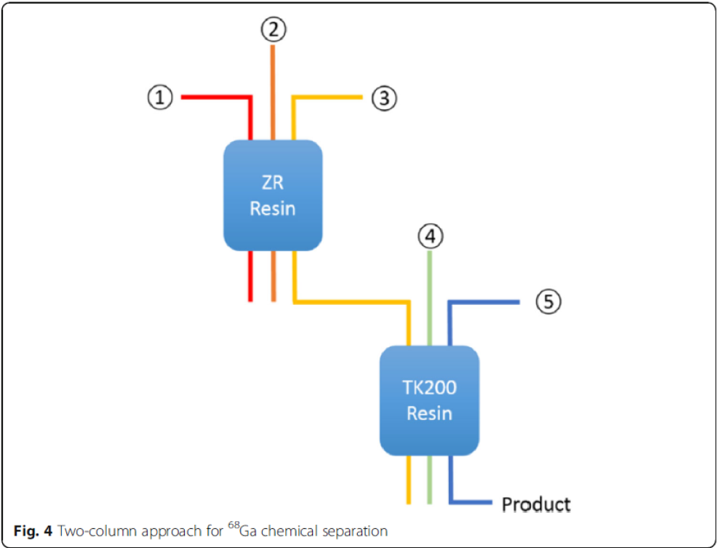
Purification Chemistry
Previous tests: AG 50W-X8
Current tests: ZR and TK 200 resins
May be future tests: TK 400

Slide 13
Publications
R. Dallakyan, A. Manukyan, A. Grigoryan, D. Arshakyan, K. Hovhannisyan, N. Dobrovolski, F. Alves. "KATIL" dissolution station for medical radiometals production using solid targets. Radiation Physics and Chemistry, Volume 245, 2026 Q2
Dallakyan, R., Dobrovolski, N., Grigoryan, A. et al. Analysis of Thermal Characteristics of Locally Inclined Targets under Irradiation by Proton Beams with a Gaussian Current Distribution. J. Contemp. Phys. 60, 1–7 (2025).
A. A. Grigoryan - Theoretical Estimation of the Activity of the Medical Isotope Gallium-68 Produced by the Reaction 68Zn(p, n)68Ga․ Journal of Contemporary Physics (Armenian Academy of Sciences), 2026, 60 (4), 381-385․

Slide 14
Renovations
430 m2 roof change
Corridor, offices and lavatory renovation
Ventilation system in Chemistry lab
Windows change
Building entrance door

Slide 15

ՇՆՈՐՀԱԿԱԼՈՒԹՅՈՒՆ

